Slide 1
P40: Introduction
Eric Prebys

Slide 2

My Background
1984: BS in Engineering Physics, University of Arizona
Got a job in an HEP group after being fired from a gas station.
1984-1990: Grad Student, University of Rochester
PhD topic: Direct Photon Production in Hadronic Interactions
1990-1992: CERN Fellow, CERN
Studied e+e- reactions on the OPAL Experiment at LEP
1992-2001: Postdoc and Assistant Professor, Princeton U.
GEM Experiment at the Superconducting Super Collider
Belle CP Violation Experiment at KEK, Japan
Nonlinear QED in E-144 Experiment at SLAC
2001-2017: Scientist, Fermilab
MiniBooNE short baseline neutrino oscillation experiment
Proton Source Department Head
Director of LHC Accelerator Research Program (LARP)
Mu2e rare muon conversion experiment
Created Lee Teng Internship and ran it for 10 years
2017-present, Professor, UC Davis
Continuing my work on Mu2e
Director, Crocker Nuclear Laboratory (cyclotron)
Experimental HEP
Accelerator Physics and HEP
Nuclear Physics
Medical Physics

Slide 3
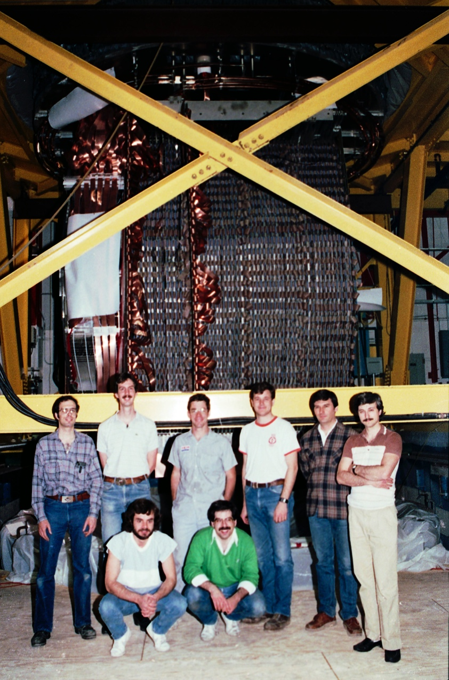

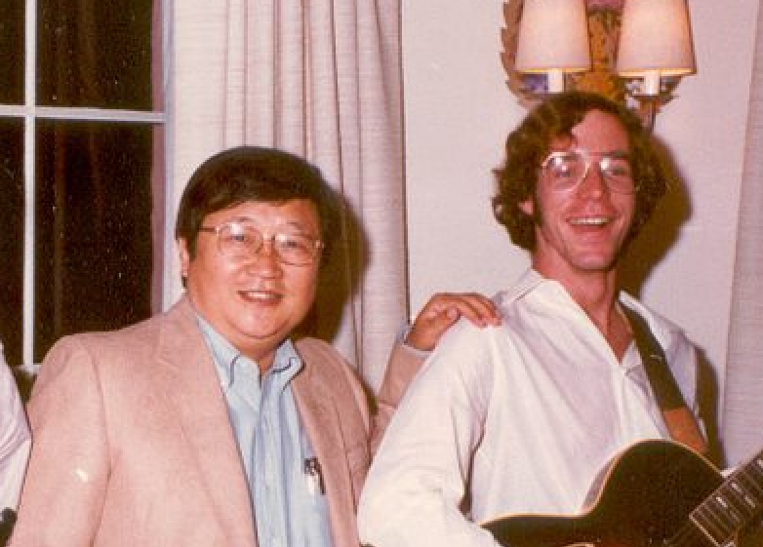

“Buck’s River Road Exxon”
Me
Kwan Lai, the guy that hired me
Fermilab E-706 Rochester Group
~1987
Recent
Then

Slide 4
A Few Points About this Class…
You’ll find this class of great practical value in the future
The new curriculum assumes a knowledge of Python/Jupyter Notebooks in the upper division classes
You’ll just find these tools very useful in your day-to-day science life.
Not all universities have this class
Even graduate students often don’t have these skills when they start out.
This is a physics class, not a programming class.
We’re going to stress understanding concepts that are important to scientific computing:
Precision
Algorithms
Efficiency
We’re not going to go into some of the more arcane aspects of Python that you would in a Python course
In fact, you’ll learn as little as possible, mostly by doing
A lot of these skills will be transferrable to other languages.

Slide 5
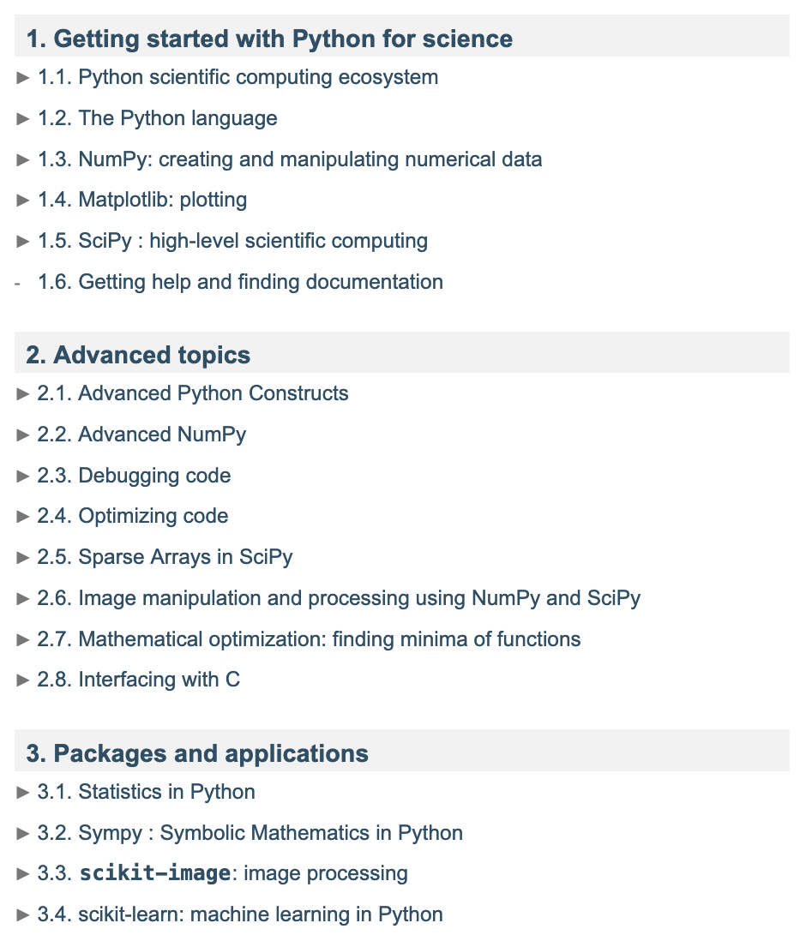

Resources for the Course
You can learn most of what you need to know about Python at https://lectures.scientific-python.org/
More information about the applications are in Gezerlis, “Numerical Methods in Physics with Python” (available for free online)

Slide 6
Schedule and Grading
Lectures Monday and and Wednesday
Labs Tuesday and Thursday
Attendance of the first lab is mandatory
Short quiz in class every Wednesday
Midterm: Wednesday, October 22, in class
Final: Thursday, December 11, 8-10AM
Grading:
10% Lab attendance
20% Midterm
10% Quizzes
40% Lab Reports
20% Final

Slide 7
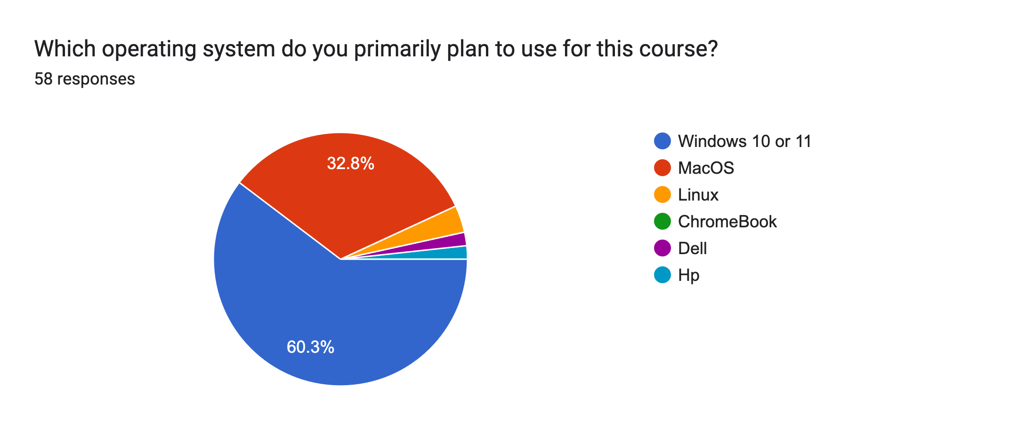
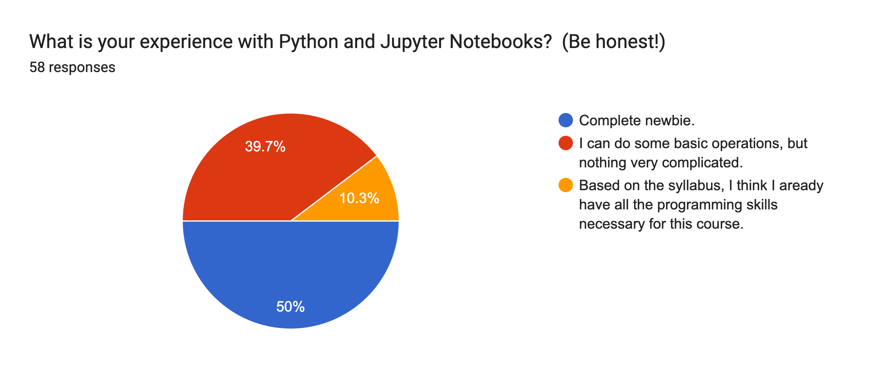
Course Demographics

Slide 8
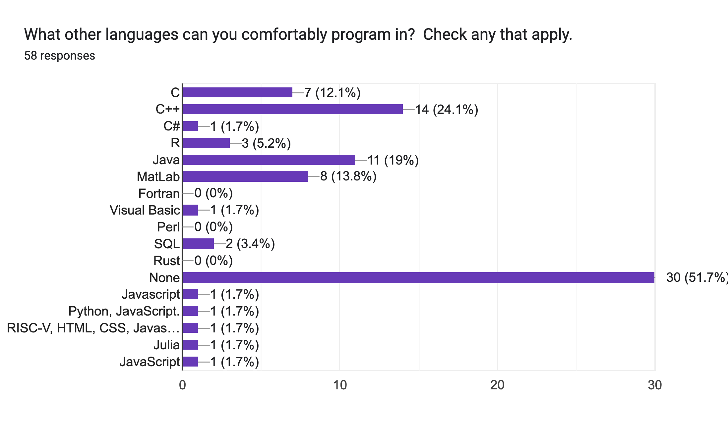
Other Experience

Slide 9
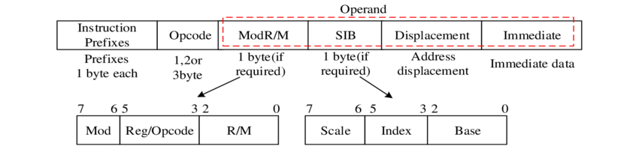
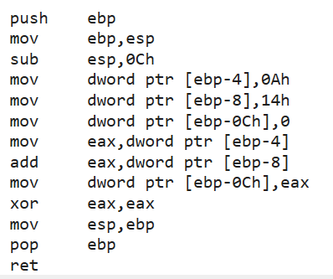
Evolution of Programming Languages
At the most fundamental level, each type of processor is controlled by groups of bits, consisting of operational code (“op code”) words and operands.
This is the final output of any programming language! x86 example:
The lowest level type of programming language is processor-dependent “assembly language”, in which human readable words are translated into op codes and mnemonics can be defined for memory locations, etc

Slide 10
Higher Level Languages
Higher level languages add more complex instruction and data handling formats that don’t directly map to processor op codes.
e.g. one line of a high-level code code can produce many individual op codes.
Higher level languages are built on lower-level languages.
This increased abstraction allows high-level codes to be platform independent, at least at some level.
Some important high-level languages over the years:
FORTRAN (“FORmula TRANSLATION”, 1957)
dominated science from its inception in 1957 until ~early 1990s
Eventually developed an object-oriented version (Fortran 90), which is still used by some today.
BASIC (“Beginners' All-purpose Symbolic Instruction Code”, 1964)
A lot of us learned programming with this language
Continues as “Visual Basic”
COBOL (“COmmon Business Oriented Language”, 1960)
Heavily used in the banking industry to this day
Never used for science
Pascal (1970)
More efficient with better memory handling tools than FORTRAN
The native language of MacOS before OSX.

Slide 11
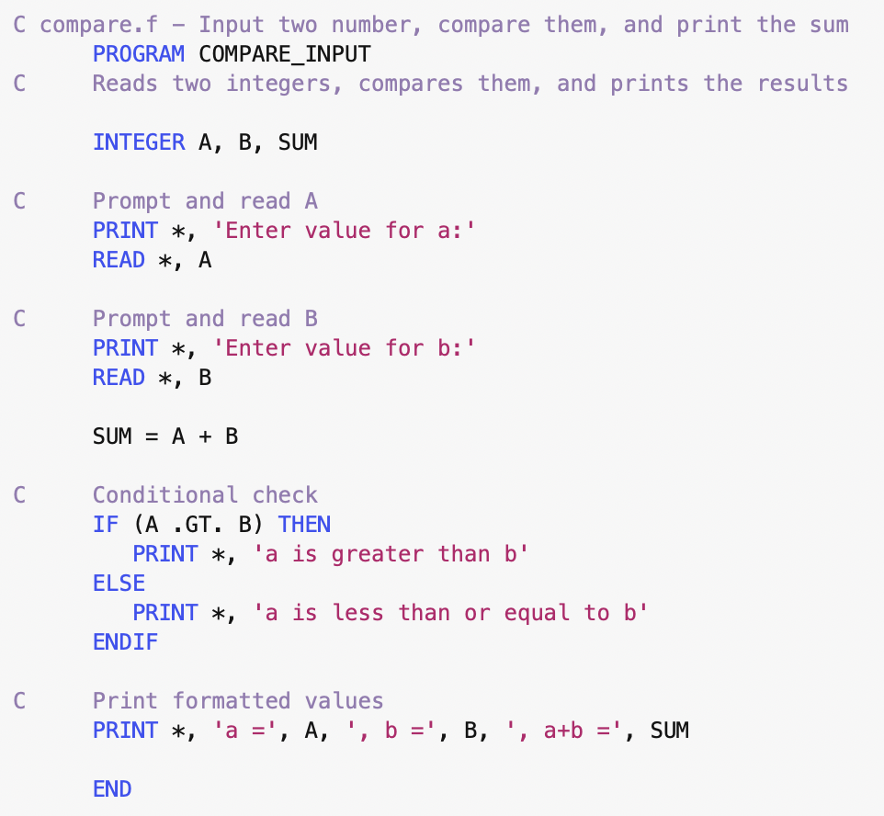
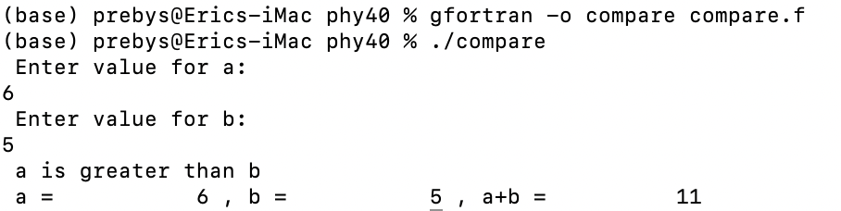
FORTRAN 77 Example
Note! Indentation is just to make it readable. It has no effect on the execution

Slide 12
C
The C programming language was released in 1972
Compared to FORTRAN, it has
dynamic memory management
More elaborate data structures
multiple levels of indirection (value, pointer, pointer to pointer)
better and more efficient tools for low level operations
Originally written to implement utilities in the Unix operating system, it eventually became the language of unix (and alter Linux) kernel.
Heavily used in the computing industry by the late 1970s
Became more and more common in physics starting around 1990 (although FORTRAN did not go quietly into that good night)

Slide 13
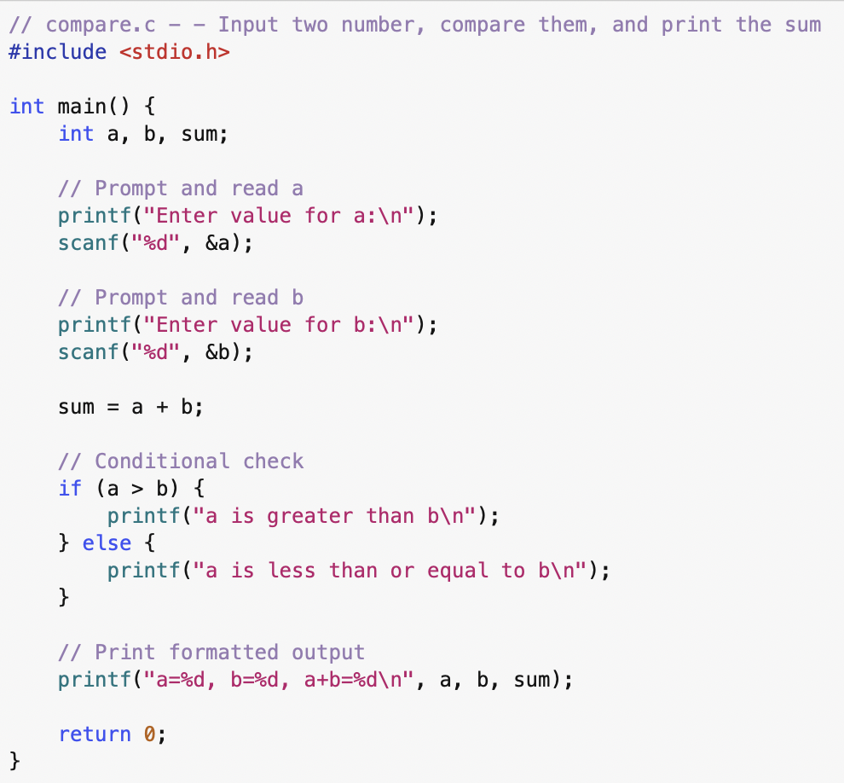
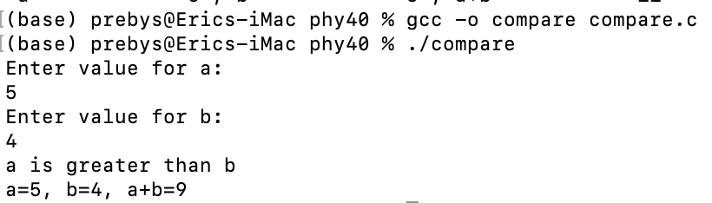
C Example

Slide 14
Object Oriented Programming
In traditional “structured” programming, data and executable code are maintained separately.
It is the programmer’s responsibility to ensure procedure gets the data it needs and that any output is stored appropriately.
In “object-oriented programming”, “objects” contain related procedures (“methods”) AND the data associated with them.
There have been many attempts at object-oriented languages, dating back to the early 1970s, but the most successful was C++, where objects (“classes”) evolved out of C data structures.
First released in 1985
Grew…”organically”
The inclusion of the “standard template library” (STL) in the mid 1990s made it much more usable.
Remains the go to language for high performance computing.

Slide 15
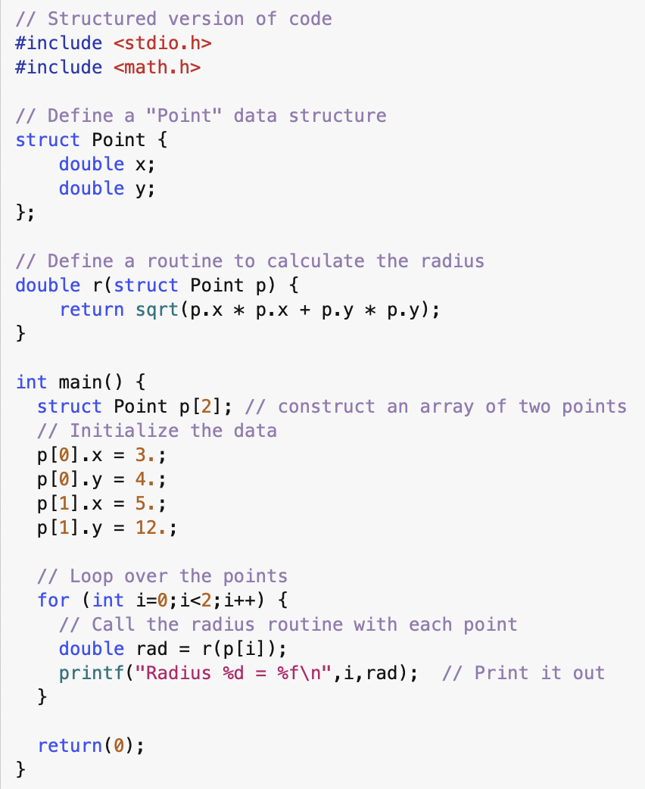
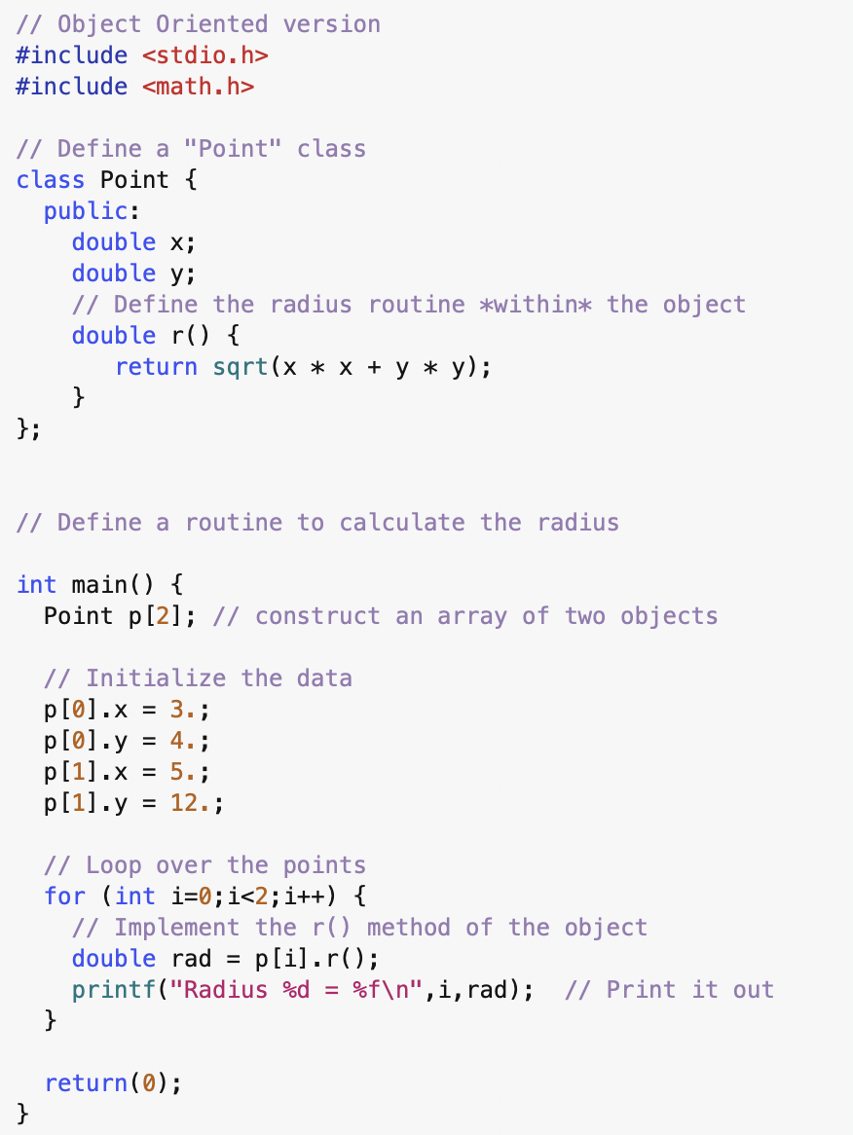
C vs. C++

Slide 16
Java
Java (not to be confused with javascript!) was released in 1995 by Sun Microsystems (now owned by Oracle)
Syntax was based on C++, but
Development was centrally controlled, so its much more self-consistent
Manifestly object oriented, as opposed to C++, which can be a hybrid
Had much better built-in GUI tools than C++
Based on a “virtual machine” model
Pros:
Made it the first credible language that was truly platform independent
The “pure” object-oriented nature make it a good learning platform
Cons:
Increased level of abstraction made direct interaction with hardware difficult
Less efficient

Slide 17
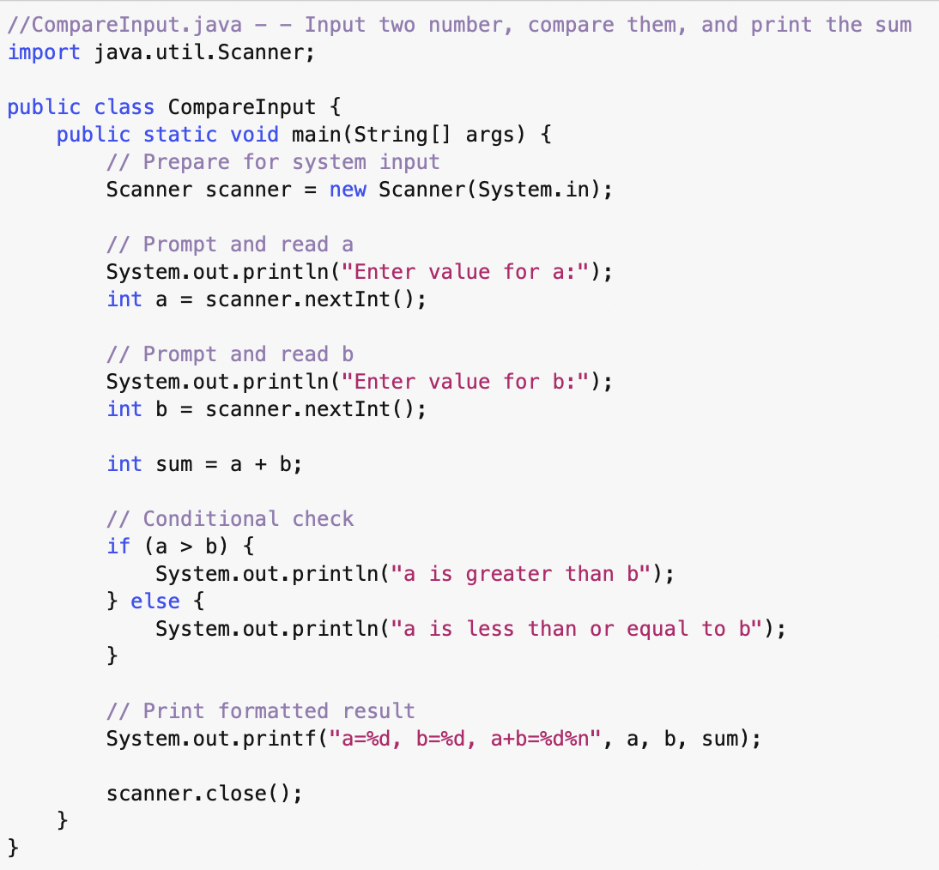
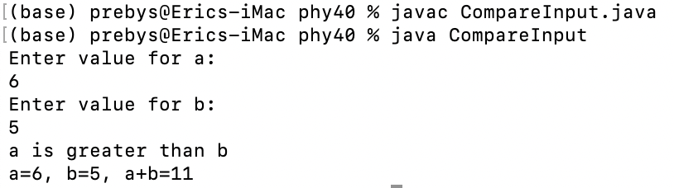
Java Example

Slide 18
Computing, Physics, and Physics Education
Computing has been a central part of physics since the early 1960s.
Lots of algorithms developed back then are still in use today.
Integrating computing into the physics curriculum has always been problematic.
Computing education was traditionally handled completely separately from physics education.
It was quite a while before people had their own computers.
There’s a bit of a learning curve with traditional languages before you get to anything useful.
If a class had a computational component, you’d typically learn that professor’s favorite language, which you’d likely use on central computing facilities.
Not everything is free!
There’s never been a clear “right answer” about how to handle this
Until now…

Slide 19


What is Python and Why is it Cool?
The development of Python began in 1989 by Guido Van Rossum, in the Netherlands
Named after Monty Python’s Flying Circus
Originally written in C
Defining features:
Readability and simplicity
Large included library
Truly cross-platform
Dynamically typed
Interpreted
Multi-paradigm
Can implement structured or object-oriented code
Easily extensible
It’s a resource hog, so it had to wait for computers to catch up to be truly useful
Usage really took off with the release of Python 2.0 in 2000
Since then, it has developed an enormous ecosystem
Python 3.0 was a backwards INcompatible release in 2008
Now the standard

Slide 20
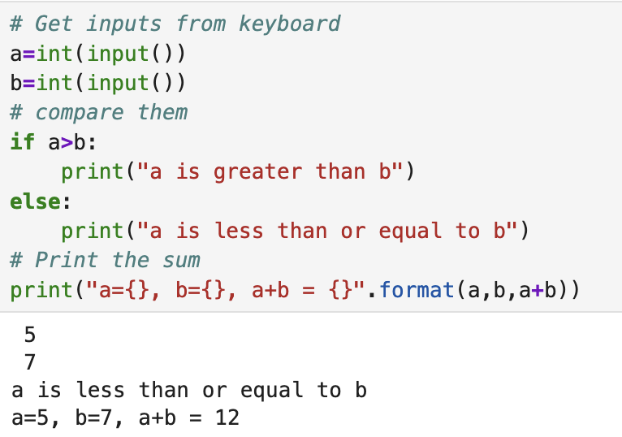
Some Pros and Cons of Python
Pros:
Basic operations are as simple as they can get
More complex things are also about as simple as they can get
Free and truly platform independent
By now there’s a Python-based solution to just about any problem you can come up with.
Cons:
The “loosey-goosey” interpreter and dynamic typing can be a blessing and a curse
Will often forgive mistakes and do what it thinks you want it to do.
As an interpreted language, it’s quite slow, which brings us to…

Slide 21
Python and Speed
Interpreted Python is extremely slow, BUT
Python packages are written in other, faster languages
The core of Python is written in C
Advanced packages are mostly written in C++
Very compute intensive stuff like machine learning may actually be running on GPUs or even firmware (FPGAs)
Whenever possible, use a utility rather than coding something yourself
We’ll do some examples of this in lab
This leads us to…

Slide 22
Python as “Glue”
Because of its universality and ease of use, many extremely complex software packages have now adopted the philosophy of developing modules in compiled languages or even on dedicated hardware, adding Python “wrappers”, and then using it to control the workflow at the top level.
Examples:
Machine learning:
scikit-learn
PyTorch
TensorFlow
Accelerator modeling:
PyOrbit
Synergia
xSuite (included with the standard Python release!)
Physical Modeling
Numerous attempts to put Python wrappers around the user hostile horror show that is Geant4

Slide 23
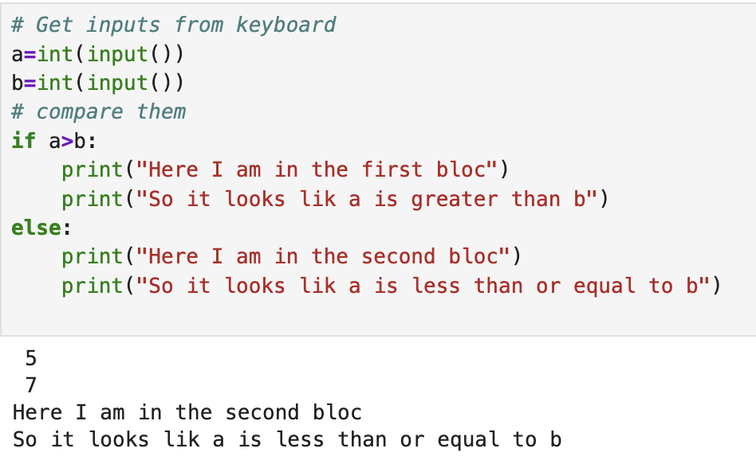
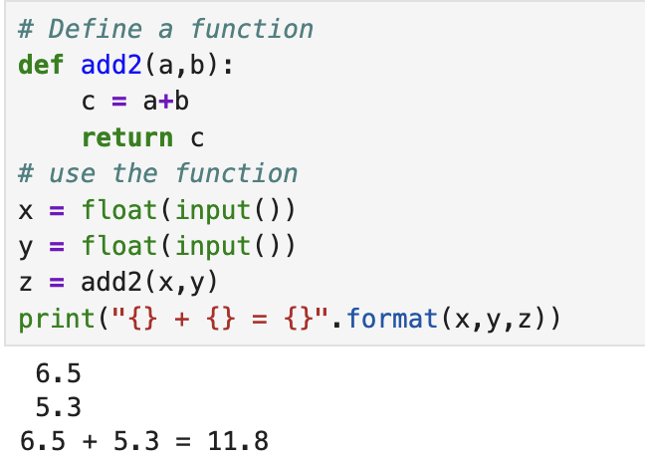
Key Features of Python
Most of Python syntax is pretty obvious and very readable
The key feature that sets it apart from all other major scientific languages is the fact that blocs of code are delimited by level of indentation:
This is known as “off-side rule”
It turns out a number of other languages use it, but I’ve never heard of ANY of them
Because it’s an interpreted languages libraries, classes, routines, etc must be declared before you can use them.

Slide 24
Some Major Python Libraries
Core Libraries for this Course
numpy: very powerful array and numerical manipulation tools
matplotlib: extensive plotting tools
scipy: more advanced tools for statistics, fitting, etc
pandas: powerful data handling and manipulation tools
Some useful utility libraries
os: interacting directly with the operating system
sys: system access complementary to os
pickle: serialization/deserialization tools. Useful for storing and restoring the state of code.
More advanced libraries
sympy: symbolic manipulation tools (goodbye MatLab!)
scikit-image: image processing tools
scikit-learn: machine learning tools (we’ll use this in 118)

Slide 25
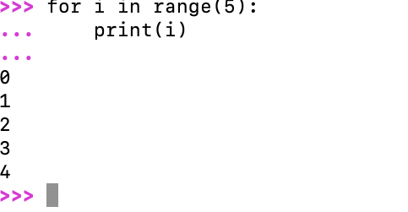
The Development of Interactive Python
Python is an interpreted language, and therefore manifestly interactive
In 2001, iPython (“Interactive Python”) was introduced.
Enhanced interactive capability, particularly for graphics
In 2011, iPython introduced browser-based “notebooks”
Even more interactive capability
Powerful markdown language to add to executable content
“Language agnostic” model supported other languages
Became the primary kernel for Project Jupyter

Slide 26
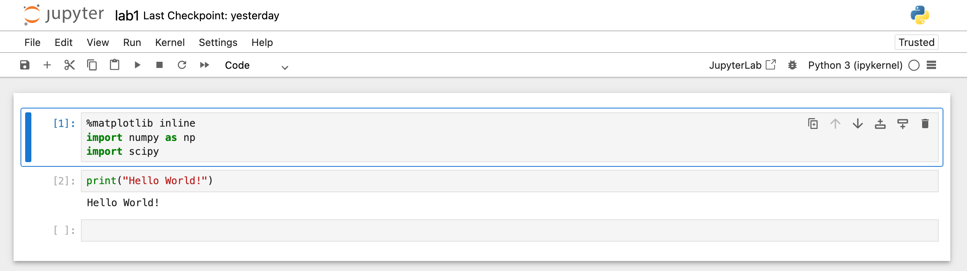
Jupyter Notebooks
In 2014, Project Jupyter spun off of iPython
Enhanced the web interface and support for other kernels
R, Julia, etc, which we won’t use
The term Jupyter Notebook can refer to
The web interface itself
The .ipynb notebook files in which it saves content

Slide 27
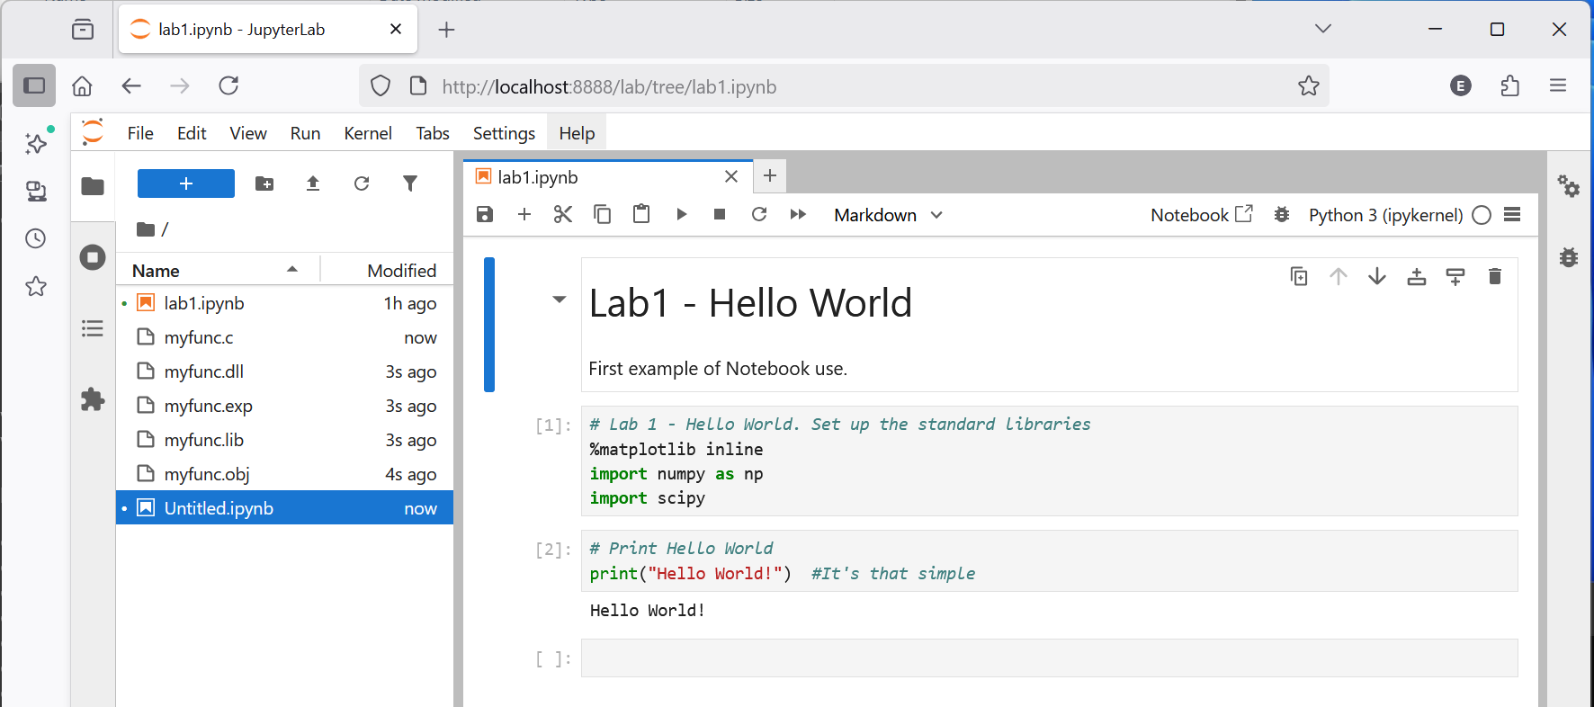
Jupyter Lab
In 2018, the JupyterLab interface was released
Same notebook format and interaction as the Jupyter Notebook interfact
Improved development environment. In particular, an integrated file browser system.

